Slide 1

GROUP 8

Slide 2
The main idea
Open-world RPG.
Player is a computer engineering student.
The game world is the University of Salerno.
The goal is to get a degree.
Tasks consist of exams to be passed and items to be picked.
The player has to manage its own status (health, stress, hunger).

Slide 3
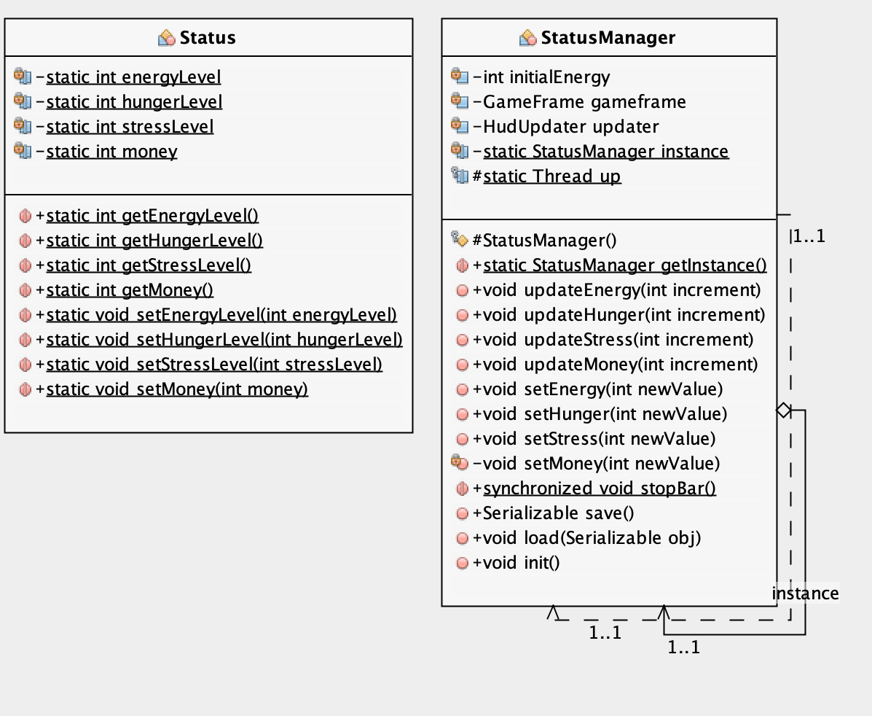
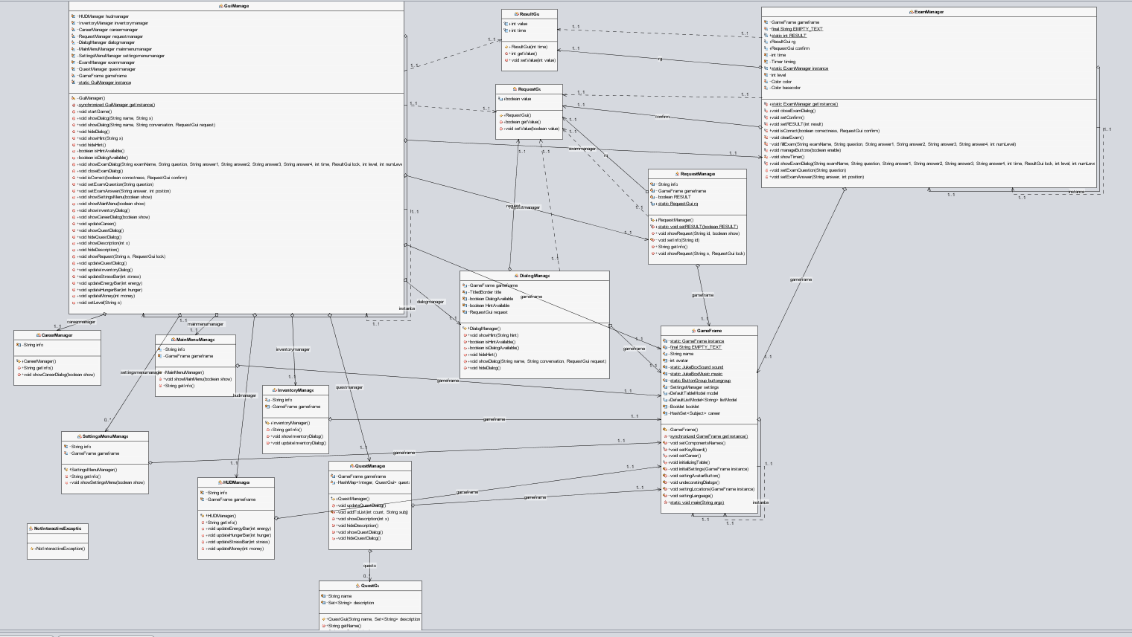
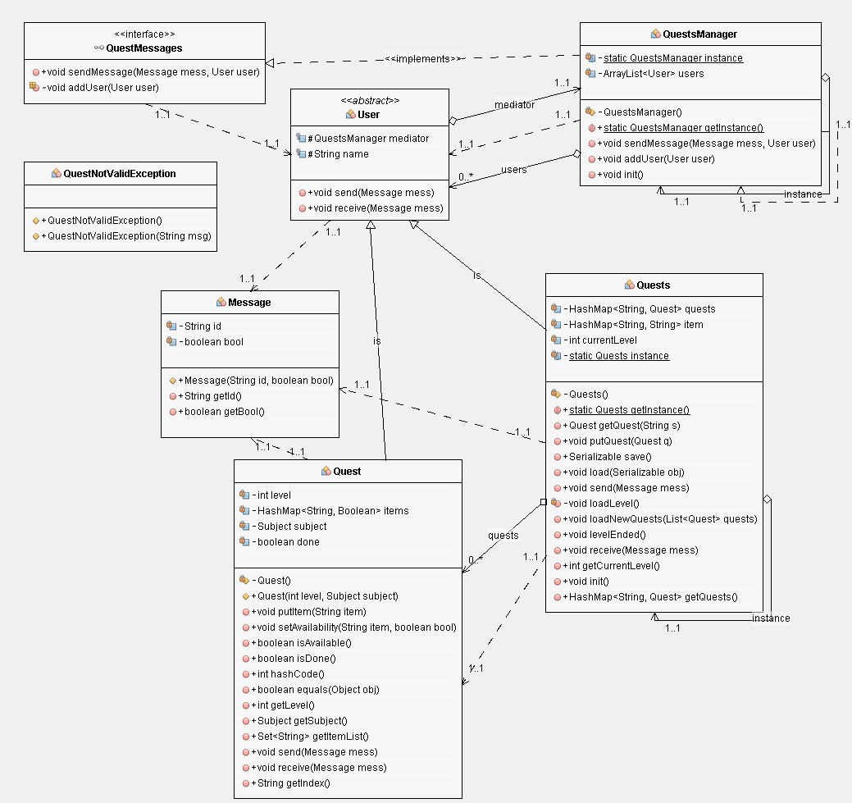
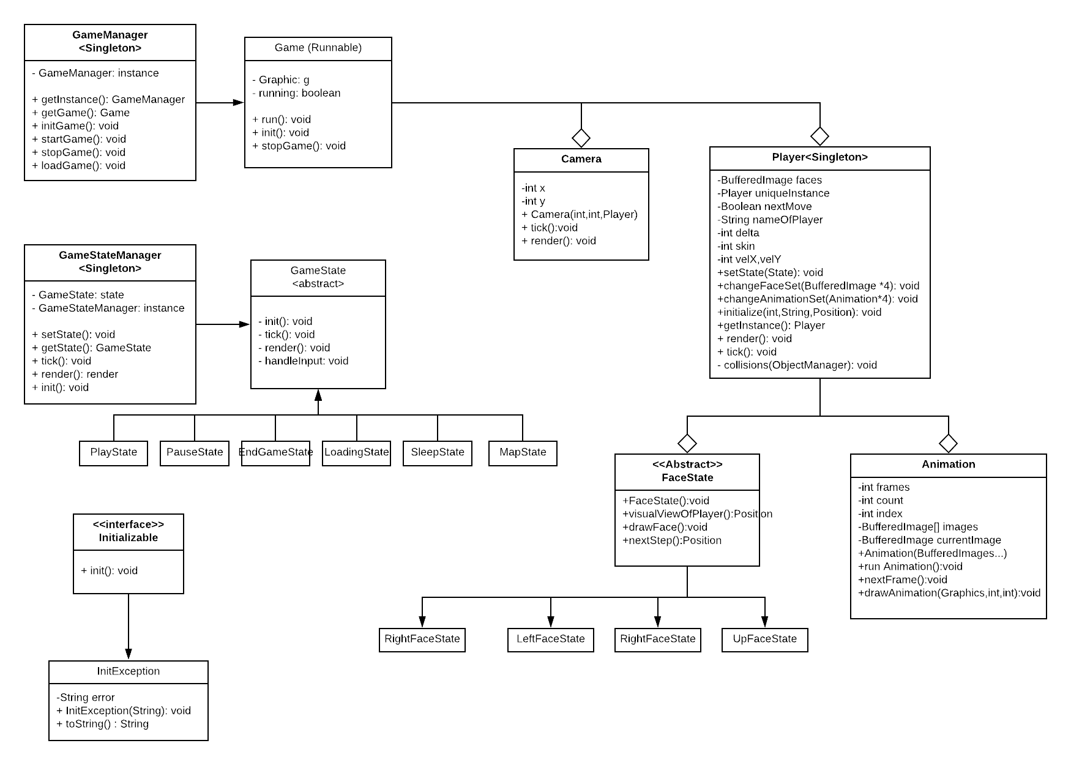
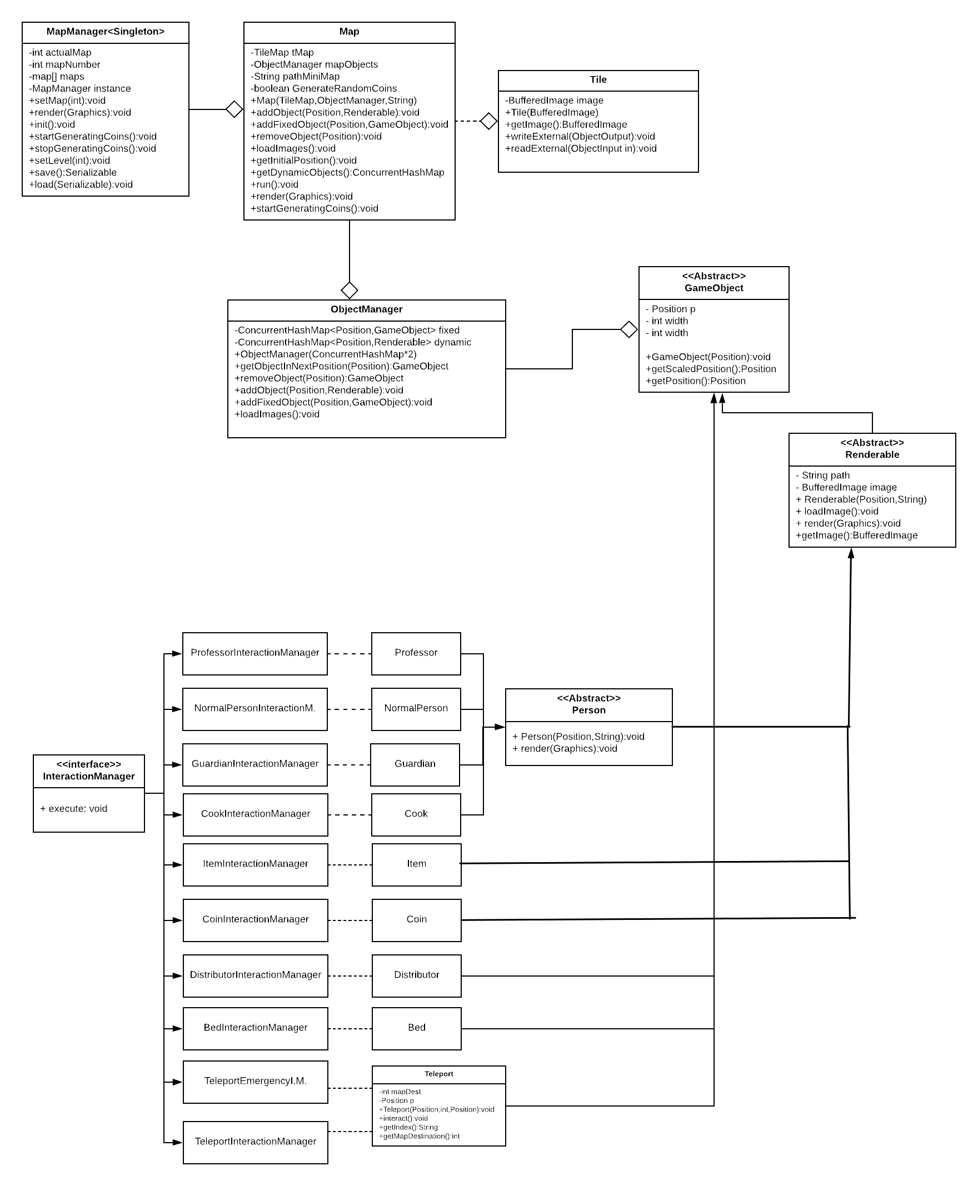
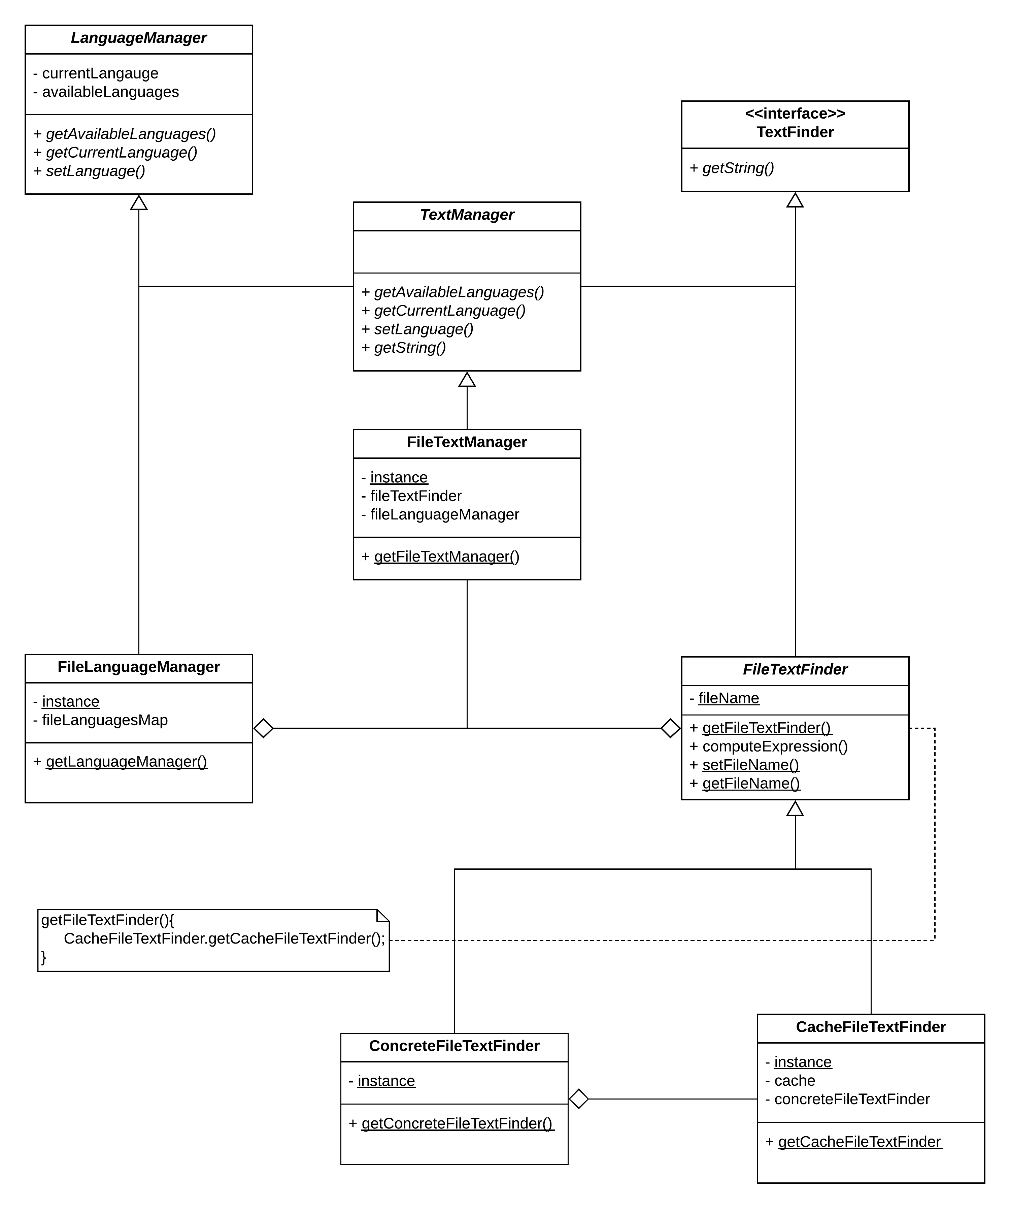
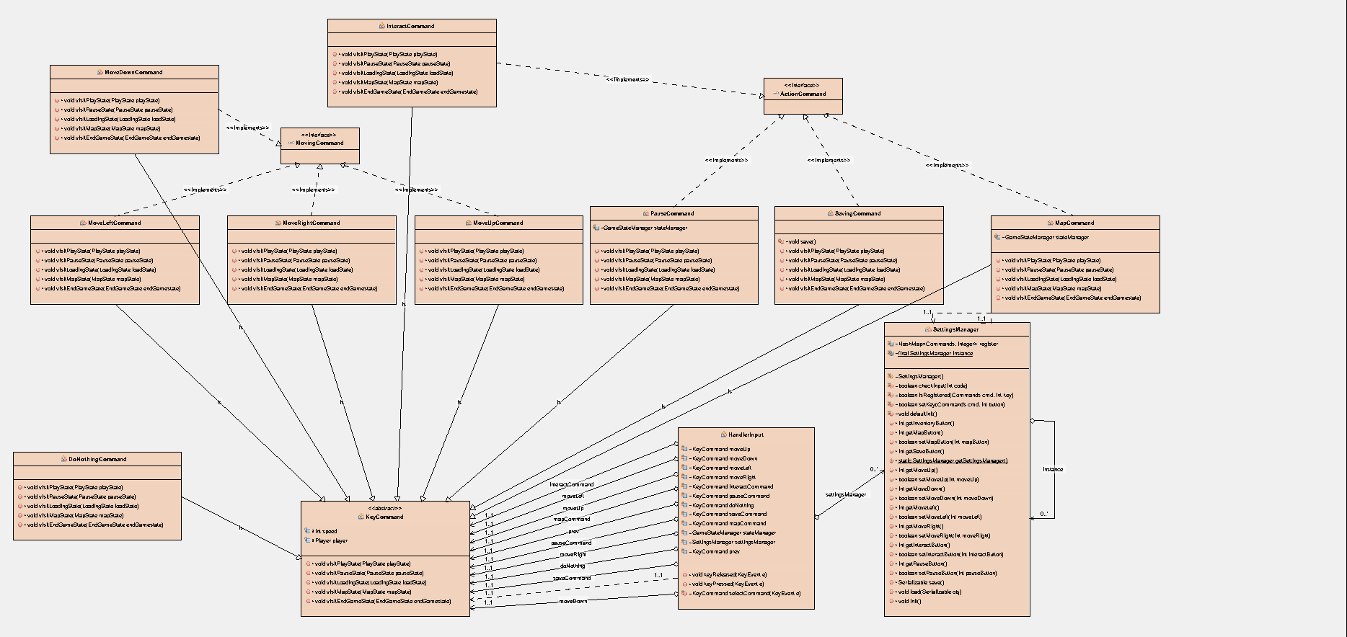
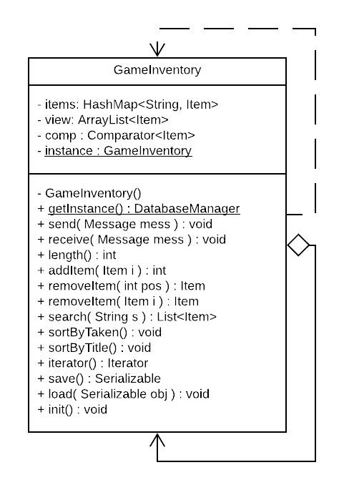
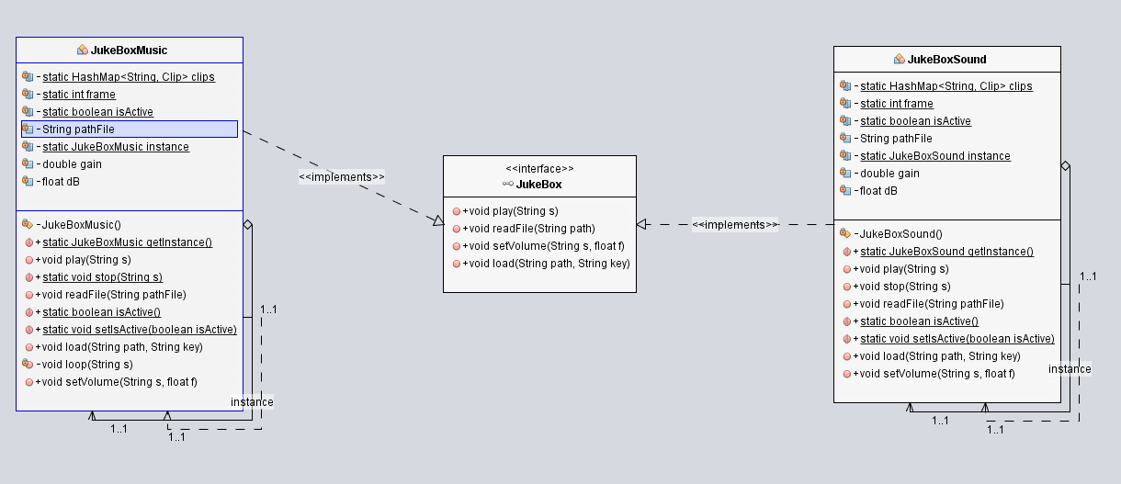
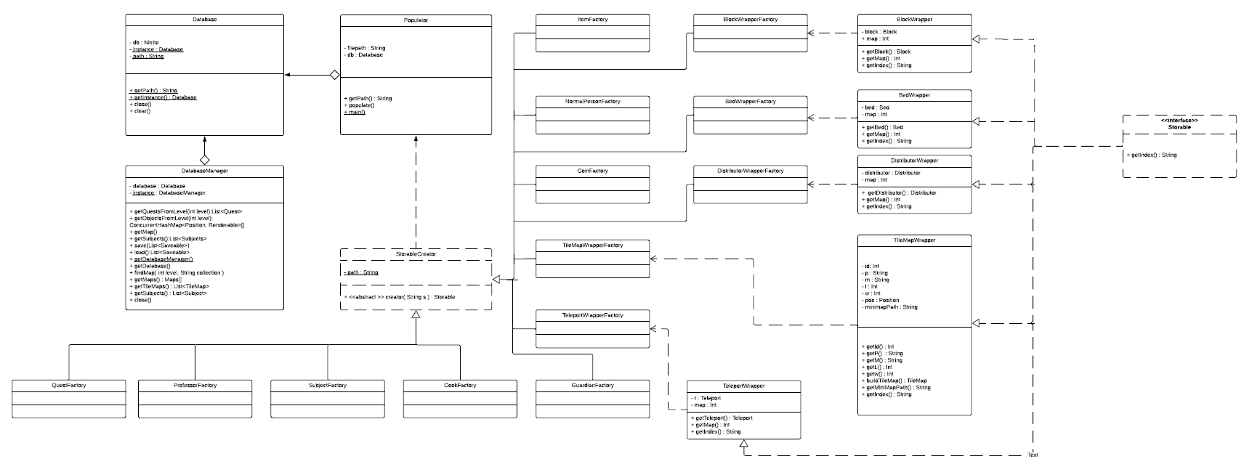
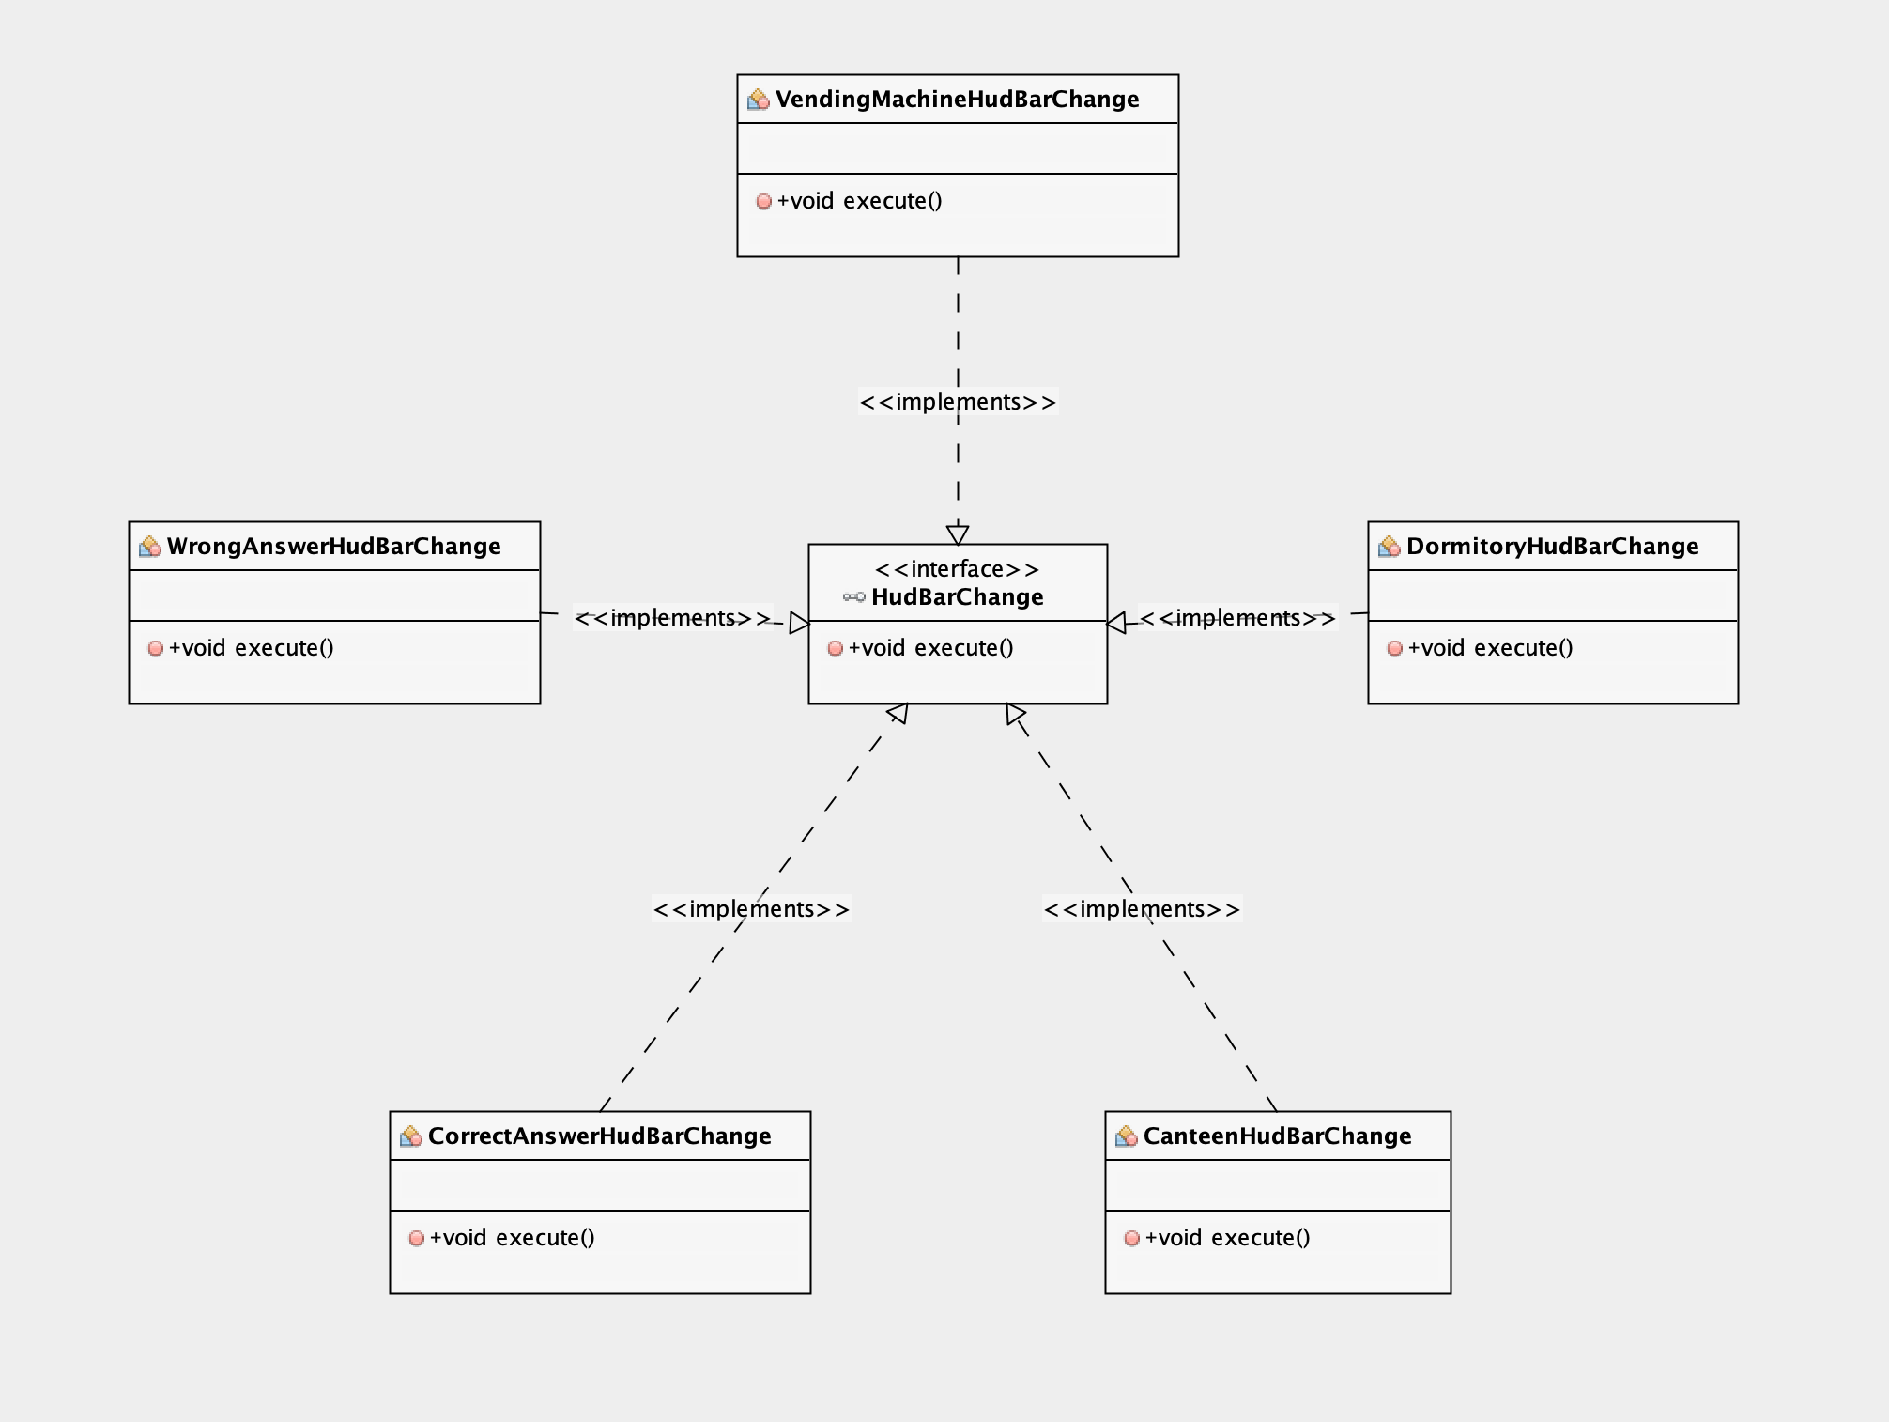
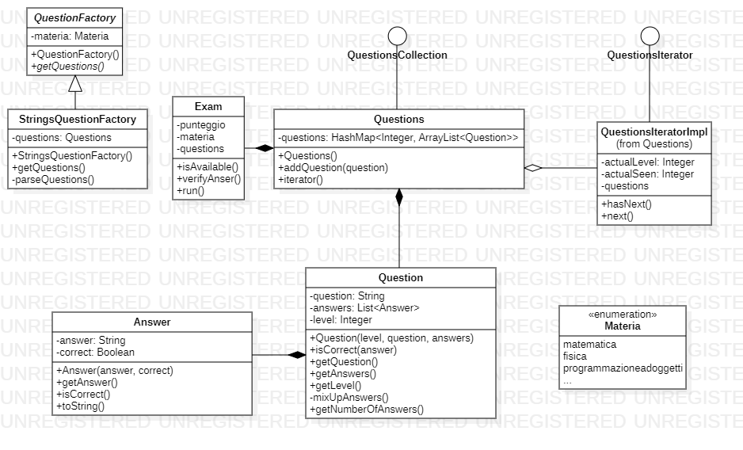
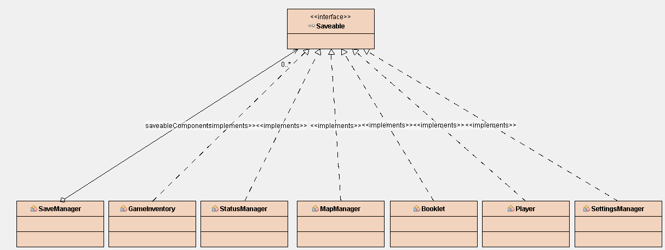
TOTAL UML

Slide 4
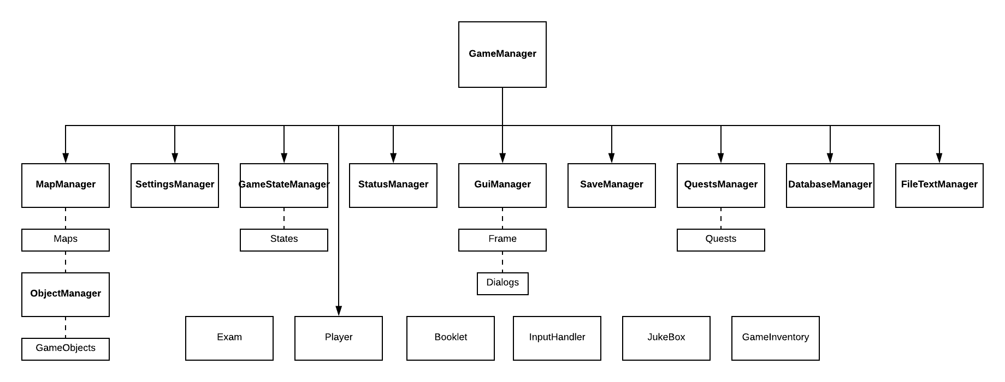
SOFTWARE ARCHITECTURE
SINGLETON
FACADE
FACTORY METHOD
STATE
VISITOR
ITERATOR
PROXY
COMMAND
MEDIATOR
STRATEGY
ADAPTER
Notes:
The game involves a lot of components, so to maintain flexibility and reduce coupling between classes we thought that each dedicated module managed by its own manager and only the managers could talk with each other.
Each component implements its own features using the appropriate pattern, so as you can see there’s a good use of theme because there’s a heterogeneity of functionalities.
Singleton for each manager Facade to reduce complexity
Mediator as additional pattern

Slide 5
USED SOFTWARE
Apache Netbeans
GitHub
Tiled
Adobe Photoshop
Gimp
StarUML
Lucid Chart
Nitrite
XPath

Slide 6
ROLES AND RESPONSABILITY
Sprint #1#2 Product Owner
Cavallaro Virginia
Coppola Davide
De Masi Alfonso
De Simone Giuseppe
De Sio Mario
Giaquinto Gennaro
Lionetti Vito
Marino Christian
Serritiello Simone
GUI
Music
Aesthetics
GUI
Music
Language
Database
Interaction
Sprint #1#2 Scrum Master
Language
Saving
Keys’ Setting
Tileset
Map
Status Bars
Sprint #3#4#5 Scrum Master
Exam
Game System
Interaction
Sprint #3#4#5 Product Owner
Exam
Quest
Map
Inventory
Quest
Database
Game System
Game Object
Player
Map

Slide 7
TESTING
Test by code
Test by human
Database
Inventory
Language
Save&Load
GUI
[Perfomed with J-Unit]
Some test were performed visually by Devs (e.g. movement of the player, map rendering, interaction with objects, exams and so on…)
Notes:
FUNCTIONAL: This type of testing ignores the internal parts and focuses only on the output to check if it is as per the requirement or not. It is a Black-box type testing geared to the functional requirements of an application.
EXPLORATORY: Exploratory Testing is informal testing performed by the testing team. The objective of this testing is to explore the application and looking for defects that exist in the application.
Sometimes it may happen that during this testing major defect discovered can even cause a system failure.
During Exploratory Testing, it is advisable to keep a track of what flow you have tested and what activity you did before the start of the specific flow.
EXAMPLE: The objective of this GUI Testing is to validate the GUI as per the business requirement. The expected GUI of the application is mentioned in the Detailed Design Document and GUI mockup screens.
The GUI Testing includes the size of the buttons and input field present on the screen, alignment of all text, tables, and content in the tables.
It also validates the menu of the application, after selecting different menu and menu items, it validates that the page does not fluctuate and the alignment remains same after hovering the mouse on the menu or sub-menu.

Slide 8
AGILE PRACTICES ADOPTED
Game concepts and features represented by USER STORIES
PRODUCT BACKLOG (Fibonacci sequence to assign story points)
SPRINTS : planning and backlog, retrospective, review
DAILY MEETINGS
PAIR PROGRAMMING

Slide 9
USED SOFTWARE
GitHub
Trello
Telegram
Slack
Discord

Slide 10
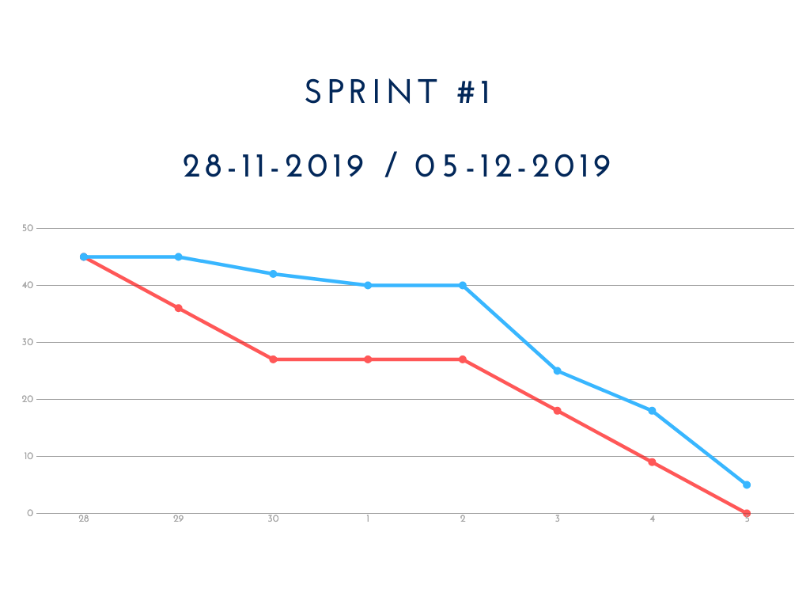
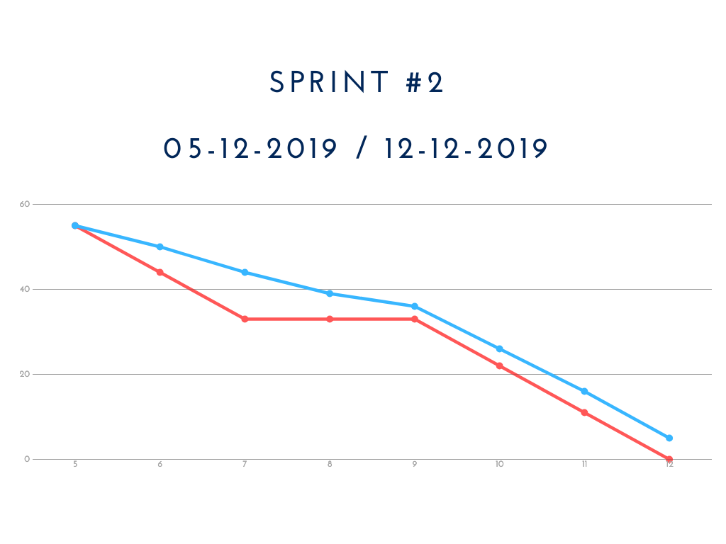
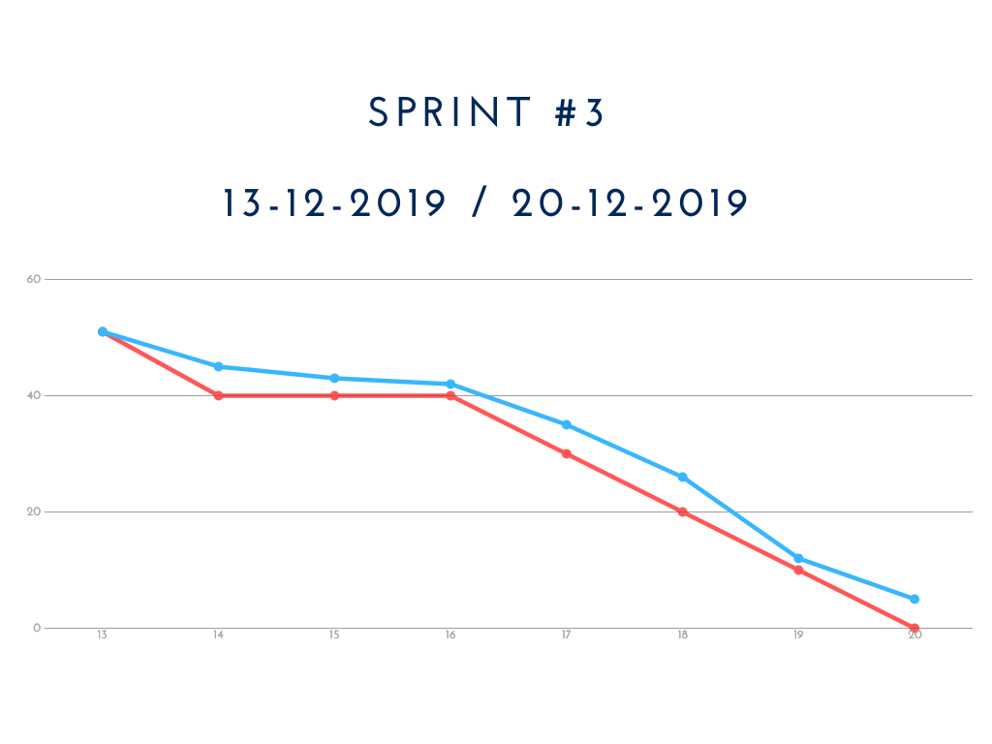
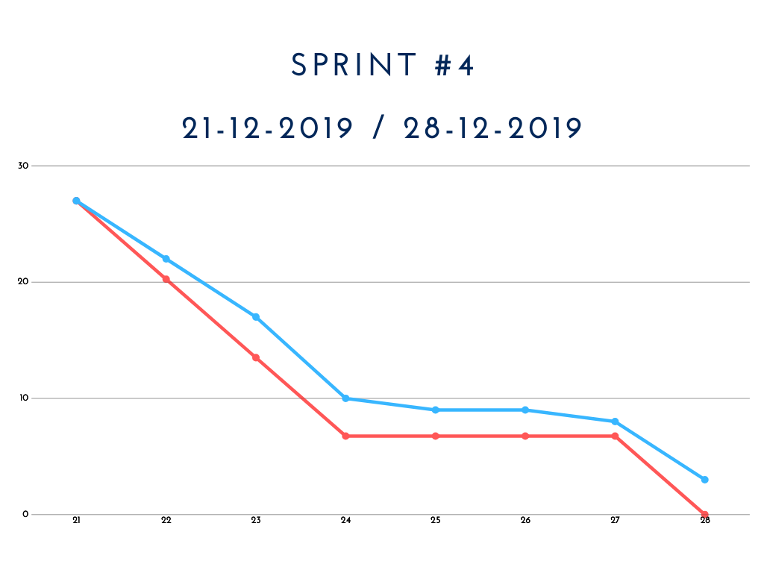
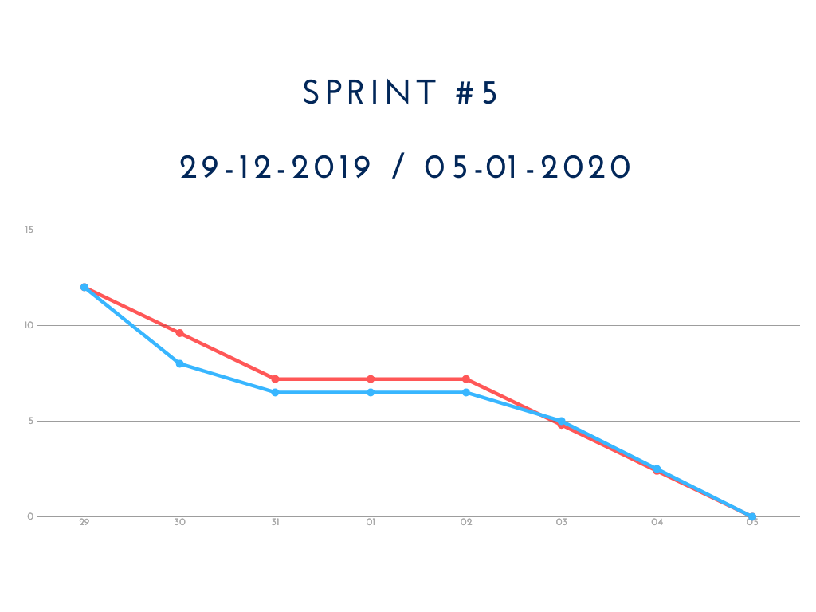
OVERIVIEW OF ALL SPRINT EXECUTED

Slide 11
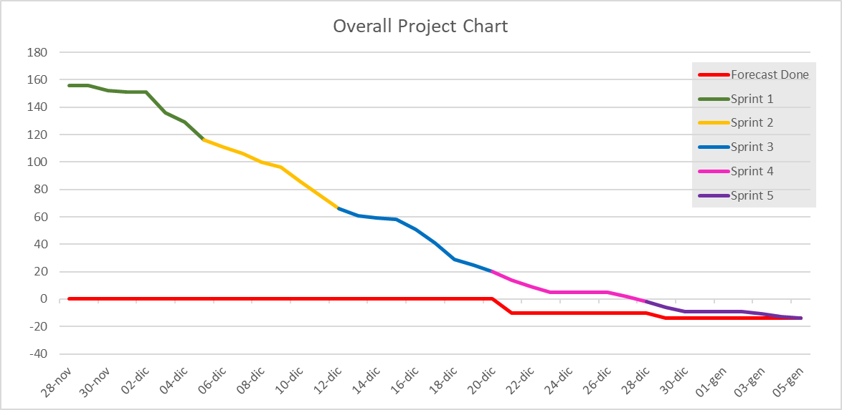
Overall project chart

Slide 12
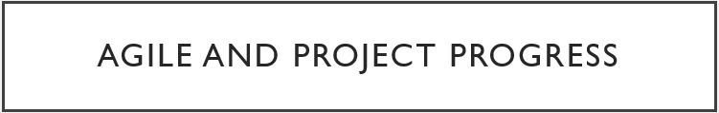
Agile and project progress
REVIEWS :
Comparison between what was done and what we expected.
Discussion about possible changes.
RETROSPECTIVES :
Pointed out critical and problematic situations in the team.
Enhancement of positive behaviours.
Highlighted time management aspects to be considered.
PROS:
Game developed in a shot time without any prior knowledge about game development.
Efficient organization of work and collaboration of the team.
CONS:
Easy to go out of the track with respect to the individual work.
Notes:
Sprint reviews helped us to understand if what we developed matched our expectations of the game.
Highlighted positive aspects of the team and this lead to an improvement of its productivity and status.
Helped us to introduce discussions about time and resources management.

Slide 13
Thanks for the attention

